Slide 1
COM4012M - CSS
Week 2 Lab Session 2

Slide 2
Note on Server Access
Check your email for a new username and password.
Follow the tutorial on how to use FileZilla to connect to ysjcs.net server with your new credentials.
Transfer your files to the server and then access them by going to https://ysjcs.net/~username/.

Slide 3
CSS
Cascading Style Sheets (CSS) is a stylesheet language used to describe the presentation of a document written in HTML or XML.
CSS describes how elements should be rendered on screen, on paper, in speech, or on other media.
It was designed primarily to allow the separation of content and presentation (layout, colours, fonts, etc).
It allows you to control the look of your website across multiple pages.
CSS can also be used to control the way a web page displays depending on the viewer's device or screen size.

Slide 4
Inline vs Internal vs External
Styling can be done in 3 ways. Inline, Internally or Externally.
Inline styling is done within a single tag like a table and will apply to that specific HTML element on that page.
Internal styling is coded at the top of the page in the Header of the HTML document and that will refer to the whole page and its individual HTML elements.
Both these methods allows for targeted styling where a certain page or elements needs to differ in some way compared to others, that won’t be repeated anywhere else.

Slide 5
Inline vs Internal vs External
However, styling is primarily done in external style sheets. These apply to the entire web page and ensure a consistent styling across multiple pages.
You should always be using External Styling for any website with more than one page.
This reduces repetition of needing to type the same styles multiple times.
Makes debugging easier.
Retains the same styling across the whole site.
Easier to update and maintain.

Slide 6
Setup a Stylesheet
A stylesheet ends with the .css file extension:
main.css
stylesheet1.css
In the header of your HTML document, you then refer to that stylesheet like so:
<link rel=“stylesheet” href=“stylesheet1.css”>
A stylesheet doesn’t have any setup specifications like a HTML document.

Slide 7
Inline Stylesheet Example
<body style= "background-color:blue; margin-left: 15%; margin-right: 15%;">}
<h1 style="font-family: Garamond, Times New Roman, serif; font-size: 200%;" >This is the page heading</h1>
<div style="background-color: rgb(204,204,255);padding: 0.5em;border: 1px solid #000000;">
Notes:
Sets the font of the heading to be Garamond, Times New Roman, or a default serif font, in that order of preference.
Makes the heading text twice as large (200%) as the default font size.
204, 204, 255: This represents a light lavender or pale blue color
padding: The CSS property that adds space inside the element's border, between the content and the border.
0.5em: The value. An em unit is relative to the font size of the element. If the font size is 16px, then 0.5em is equivalent to 8px. In essence, this means a padding of half the font size is applied to all sides of the content within the <div>.
border: 1px solid #000000;”: Adds a 1-pixel solid black border around the <div>.

Slide 8
Internal Stylesheet Example
<!DOCTYPE html>
<html>
<head>
<style>
#myDIV {
color: blue;
} border: 10px solid currentcolor;
</style>
</head>
<body>

Slide 9
External Stylesheet Example
h1{
margin: 0px
background-color: rgb(132, 202, 245);
width: 100%
color: black;
text-align: center;
font-size: 80px;
}
.Style1 {
font-family: Arial, Helvetica, Verdana, sans-serif;
font-weight: bold;
color: “#00FF00”;
}

Slide 10
External Stylesheet Example
h1{
margin: 0px
background-color: rgb(132, 202, 245);
width: 100%
color: black;
text-align: center;
font-size: 80px;
}
You can create custom tags using the .Name {
.Style1 {
font-family: Arial, Helvetica, Verdana, sans-serif;
font-weight: bold;
color: “#00FF00”;
}

Slide 11
Stylesheet Priority
You can combine using all 3 methods of stylesheet for a single website, in which case in terms of what style gets applied it’s always the most specific:
Inline > Internal > External
This also applies to the tags you use, for example having a Div class be given .Style2 would be overwritten by a paragraph having p styling.

Slide 12
Colours (Color)
Text Colour:
<h1 style="color:Violet;">Hello World</h1>
Background Colour:
<h1 style="background-color:DodgerBlue;">Hello World</h1>
Border Colour:
<h1 style="border:2px solid Tomato;">Hello World</h1>

Slide 13
Colours (Color)
There are several ways to choose colours in CSS:
Predefined colour names (CSS has 140 options)
<h2 style="background-color:Tomato;">Tomato</h2>
RGB Colours (Red, Green, Blue)
<h2 style="background-color:rgb(255, 0, 0);">Red</h1>
Hexadecimal (#RRGGBB, RedGreenBlue hexademical integers)
<h2 style="background-color:#0000ff;">Blue</h2>
HSL (Hue, Saturation, Lightness)
<h2 style="background-color:hsl(147, 50%, 47%);">Green</h2>

Slide 14
Colours (Color)
You can also add in transparency to colour using either RGBA or HSLA, this would be 50% transparent ->
<h1 style="background-color:rgba(255, 99, 71, 0.5);">h1>
Also keep in mind using a general colour theme to your websites, to keep your sites easy to read and professional looking.
http://colorexplorer.com/
(This is obviously more of an art/designer thing)

Slide 15
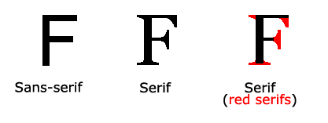
Fonts
In CSS there are five generic font families:
Serif fonts have a small stroke at the edges of each letter. They create a sense of formality and elegance.
Sans-serif fonts have clean lines (no small strokes attached). They create a modern and minimalistic look.
Monospace fonts - here all the letters have the same fixed width. They create a mechanical look.
Cursive fonts imitate human handwriting.
Fantasy fonts are decorative/playful fonts.
In general, Sans-Serif fonts are considered easier to read on computer screens than Serif fonts.

Slide 16
Fonts
.p1 {
font-family: "Times New Roman", Times, serif;
}
Times New Roman
.p2 {
font-family: Arial, Helvetica, sans-serif;
}
Arial
.p3 {
font-family: "Lucida Console", "Courier New", monospace;
}
Lucida Console

Slide 17
Text (Size)
h1 {
font-size: 25px;
}
body {
font-size: 100%;
}
p {
font-size: 0.875em;
}

Slide 18
Text (Alignment)
h1 {
text-align: center/left/right;
}
h1 {
text-align: justify;
}

Slide 19
Text (Decoration Lines)
h1 {
text-decoration-line: overline;
}
h2 {
text-decoration-line: line-through;
}
h3 {
text-decoration-line: underline;
}
p {
text-decoration-line: overline underline;
}

Slide 20
Text (Bold)
p.normal {
font-weight: normal;
}
p.light {
font-weight: lighter;
}
p.thick {
font-weight: bold;
}
p.thicker {
font-weight: 900;
}

Slide 21
Text (Style)
H1 {
font-style: normal;
}
p{
font-style: italic;
}
p.{
font-style: oblique;
}

Slide 22
Text (Spacing)
p {
text-indent: 50px;
}
h1 {
letter-spacing: 5px;
}
p. {
line-height: 0.8px;
}
p {
word-spacing: 10px;
}

Slide 23
Borders
The CSS border properties allow you to specify the style, width, and color of an element's border.
p.one {
border-style: solid;
border-width: 5px;
border-color: red;
border-radius: 5px;
}
p.two {
border-top-style: dotted;
border-right-style: solid;
border-bottom-style: dotted;
border-left-style: solid;

Slide 24
Borders
p.dotted {border-style: dotted;}
p.dashed {border-style: dashed;}
p.solid {border-style: solid;}
p.double {border-style: double;}
p.groove {border-style: groove;}
p.ridge {border-style: ridge;}
p.inset {border-style: inset;}
p.outset {border-style: outset;}
p.none {border-style: none;}
p.hidden {border-style: hidden;}
p.mix {border-style: dotted dashed solid double;}

Slide 25
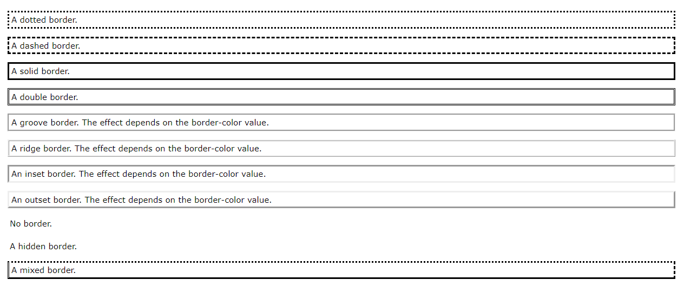
Borders

Slide 26
Margin
Margins are used to create space around elements, outside of any defined borders.
p {
margin-top: 100px;
margin-bottom: 100px;
margin-right: 150px;
margin-left: 80px;
}
Shorthand version:
p {
margin: 25px 50px 75px 100px;
}

Slide 27
Padding
Padding is used to create space around an element's content, inside of any defined borders.
p {
padding-top: 100px;
padding-bottom: 100px;
padding-right: 150px;
padding-left: 80px;
}
Shorthand version:
p {
padding: 25px 50px 75px 100px;
}

Slide 28

CSS Box Model

Slide 29
IDs and Classes
Ids identify individual tags; they are unique and there can only be one id per page with the same name.
#first {font-color:red}
#second{font-color:blue}
Classes can identify multiple tags, so there can be multiple tags with the same class name across the same page.
.quotation {margin-left:10%;margin-right:10%; font-style:italic}
.warning {border:5px solid red;text-align:center}
.question {font-weight:bold;color:blue;background-color:yellow}
This defines styles for the quotation, warning, and question classes of the p tag and for the first and second ids.

Slide 30
IDs and Classes
These styles would then be used in the following way:
<p id=”first”>The following quotation is from a Charles Dickens novel:</p> <p class="quotation">I am well aware that I am the 'umblest person going. My mother is likewise a very 'umble person. We live in an ‘umble abode.</p> <p>Now answer the following questions:</p> <p class="question">In which novel does this quotation appear?</p> <p class="question">Who says it?</p> <p class="question" id=”second”>Who do they say it to?</p> <p>Note:</p> <p class="warning">You only win a prize if you get all 3 questions right.</p>

Slide 31
HTML DIV
The <div> element is used as a container for other HTML elements.
.myDiv {
border: 5px outset red;
background-color: lightblue;
text-align: center;
}
<body>
<div class="myDiv">
<h2>This is a heading in a div element</h2>
<p>This is some text in a div element.</p>
</div>
</body>

Slide 32
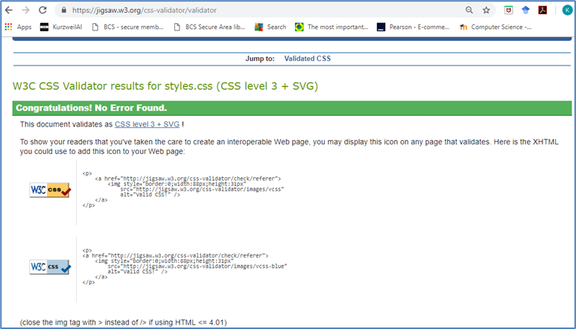
CSS Validation
The W3C CSS Validation Service can be used to check the correctness (validity) of W3.CSS.
https://validator.w3.org/

Slide 33
Sourced
www.w3schools.com

